Slide 1


Mark Fickman
2022

Slide 2

Outline
Executive Summary
Introduction
Methodology
Results
Conclusion

Slide 3
Executive Summary
Summary of methodologies
Data Collection & Wrangling with REST API
Data Collection & Web Scraping
Exploratory Data Analysis with SQL
Exploratory Data Analysis with Pandas & MatPlotLib
Interactive Visual Analytics Dashboard with Folium
Interactive Visual Analytics Dashboard with Dash Plotly
Predictive Analysis (Classification)
Summary of all results
Results Via Analysis
Results Via Visualization
Results Via Predictive Analytics

Slide 4
Introduction
Project background and context
SpaceX advertises Falcon 9 rocket launches on its website, with a cost of 62 million dollars; other providers cost upward of 165 million dollars each, much of the savings is because SpaceX can reuse the first stage. Therefore if we can determine if the first stage will land, we can determine the cost of a launch. This information can be used if an alternate company wants to bid against SpaceX for a rocket launch.
Problems you want to find answers
What factors will affect the landing success rate
What machine learning algorithms will provide the most accurate prediction for future landings
https://github.com/mfickman/DataScienceCapstone

Slide 5

Section 1

Slide 6
Methodology
Executive Summary
Data collection methodology:
Data was collected using the SpaceX Rest API endpoint as well as web scrapping via beautiful soup from Wikipedia.
Perform data wrangling
Perform exploratory data analysis (EDA) using visualization and SQL
Perform interactive visual analytics using Folium and Plotly Dash
Perform predictive analysis using classification models

Slide 7
Data Collection
Data was collected via two methods
Method 1: REST API
The request module was utilized to perform a GET request on the SpaceX REST API endpoint in order to pull landing data.
A dataframe was created after converting the response content to proper JSON format
Method 2: Web Scrapping
The BeautifulSoup module was utilized to in order to perform web scrapping on the SpaceX Wikipedia page.
The HTML table was identified, parsed, and converted to a dataframe

Slide 8
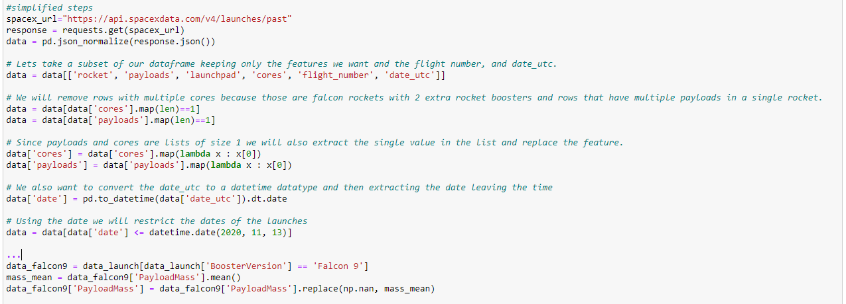
Data Collection – SpaceX API
A GET request was used against the SpaceX REST API endpoint in order to retrieve data. Data cleansing was performed via standard pandas operations
https://github.com/mfickman/DataScienceCapstone/blob/v1.0.0/Week1%20Data%20Collection%20w%20Rest%20API.ipynb

Slide 9
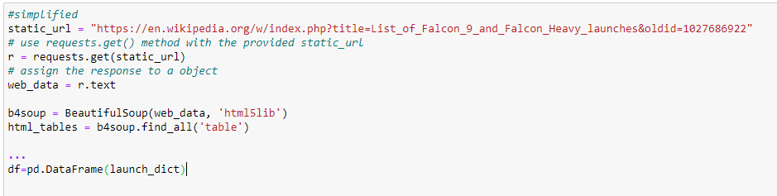
Data Collection - Scraping
Utilizing the BeautifulSoup module, we web scrapped for data from the SpaceX Wikipedia page. We identified the table via the html tags, and converted to a dataframe. Data cleansing was performed via standard pandas operations.
https://github.com/mfickman/DataScienceCapstone/blob/master/Week%201%20Data%20with%20Web%20Scraping.ipynb

Slide 10
Data Wrangling
Exploratory data analysis was performed in order to identify the training labels
Data wrangling facilitated the accomplishment of the following 4 tasks:
Calculate the number of launches on each site
Calculate the number and occurrence of each orbit
Calculate the number and occurrence of mission outcome per orbit type
Create a landing outcome label from Outcome column
https://github.com/mfickman/DataScienceCapstone/blob/master/Week%201%20Data%20Wrangling.ipynb

Slide 11
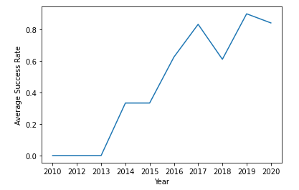
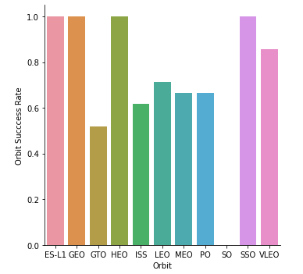
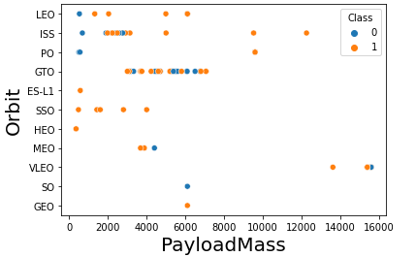
EDA with Data Visualization
pandas, matplotlib, and seaborn were utilized to perform data analysis and feature engineering.
The data was visualized using scatter plots, bar graphs, and line plots in order to better understand the relationships between flight number and payload mass, flight number and launch site, orbit type and success rate, flight number and orbit, payload mass and orbit, as well as success rate over time.
https://github.com/mfickman/DataScienceCapstone/blob/master/Week2%20Exploratory%20Data%20Analysis%20(EDA)%20with%20pd%20%26%20ml.ipynb

Slide 12
EDA with SQL
Data was loaded into a PostgreSQL database from a static csv file
Exploratory data analysis was performed using sqlalchemy in order to identify key insights from the data.
The following analysis was performed via sql queries:
the names of the unique launch sites in the space mission
5 records where launch sites begin with the string 'CCA'
total payload mass carried by boosters launched by NASA (CRS)
average payload mass carried by booster version F9 v1.1
date when the first successful landing outcome in ground pad was achieved
names of the boosters which have success in drone ship and have payload mass greater than 4000 but less than 6000
total number of successful and failure mission outcomes
names of the booster_versions which have carried the maximum payload mass
failed landing_outcomes in drone ship, their booster versions, and launch site names for in year 2015
https://github.com/mfickman/DataScienceCapstone/blob/master/Week%202%20Exploratory%20Data%20Analysis%20(EDA)%20with%20SQL.ipynb

Slide 13
Build an Interactive Map with Folium
Summarize what map objects such as markers, circles, lines, etc. you created and added to a folium map
Explain why you added those objects
https://github.com/mfickman/DataScienceCapstone/blob/master/Week%203%20Interactive%20Visual%20Analytics%20Dashboard.ipynb

Slide 14
Build a Dashboard with Plotly Dash
Summarize what plots/graphs and interactions you have added to a dashboard
Explain why you added those plots and interactions
https://github.com/mfickman/DataScienceCapstone/blob/master/Week%203%20Plotly%20Dashboard%20Code.ipynb

Slide 15
Predictive Analysis (Classification)
The final step of our analysis was identifying the best model to use for predictive analysis
Data was split into training and testing sets, and then 4 separate machine learning models were trained and tested against the data
Models were tuned using different hyperparamters via GridSearchCV
Model accuracy was the single parameter used to identify the best model for classification
https://github.com/mfickman/DataScienceCapstone/blob/master/Week%204%20Predictive%20Analysis%20(Classification).ipynb

Slide 16
Results
Exploratory data analysis results
Interactive analytics demo in screenshots
Predictive analysis results

Slide 17

Section 2

Slide 18
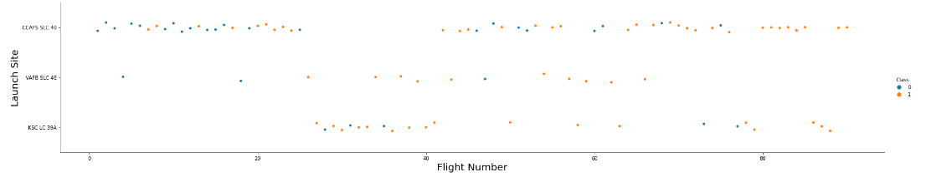
We see that different launch sites have different success rates. CCAFS LC-40, has a success rate of 60 %, while KSC LC-39A and VAFB SLC 4E has a success rate of 77%.
Flight Number vs. Launch Site
The plot showed a general increase in success rate across all launch sites as flight number increased

Slide 19
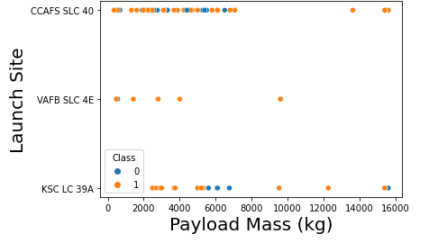
Payload vs. Launch Site
The plot shows for the VAFB-SLC launch site that there are no rockets launched for heavy payload mass (greater than 10000 kg)

Slide 20
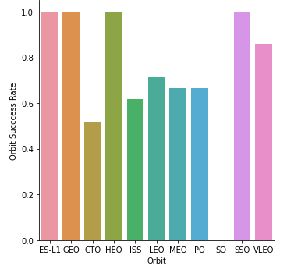
Success Rate vs. Orbit Type
The plot shows a significant difference in success rate for Orbits ES-L1, GEO, HEO, and SSO compared to the other orbits

Slide 21
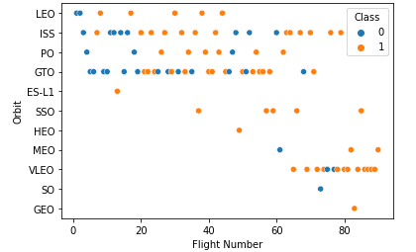
Flight Number vs. Orbit Type
The plot shows the impact that flight number has on the success rate for the LEO orbit
The success rate for the GTO seems to be unrelated to the flight number

Slide 22
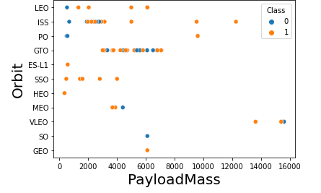
Payload vs. Orbit Type
The Polar, LEO, and ISS orbit have a high success rate with heavy payloads
The impact of payload mass on success rate for other orbits, such as the GTO orbit, is not discernable from the plot

Slide 23
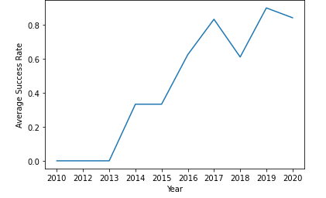
Launch Success Yearly Trend
The plot shows the increase in success rate from 2013 till 2020

Slide 24
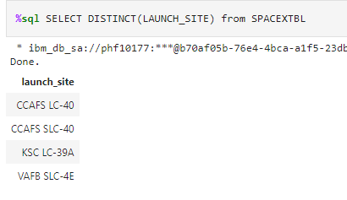
All Launch Site Names
The DISTINCT keyword was used to identify unique launch sites

Slide 25
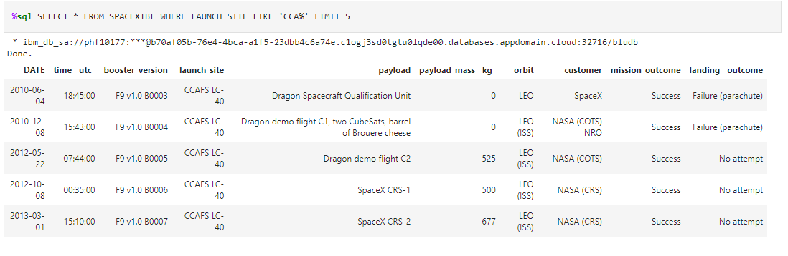
Launch Site Names Begin with 'CCA'
The ‘%’ wildcard was used to identify all launch sites that start with ‘CCA’
The LIMIT keyword was used to reduce the result set to only 5 records

Slide 26
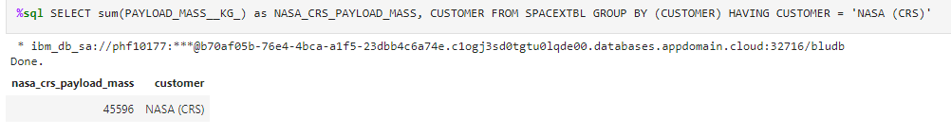
Total Payload Mass
The GROUP BY clause was used in conjunction with the SUM aggregate function to add up the payload mass for all NASA (CRS) records

Slide 27
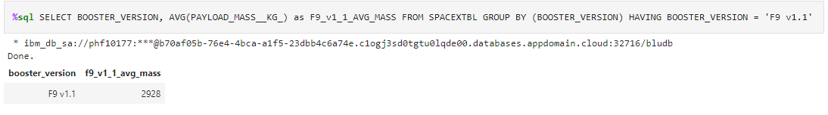
Average Payload Mass by F9 v1.1
The GROUP BY clause was used in conjunction with the AVG aggregate function to compute the mean payload mass for all F9 v1.1 booster records

Slide 28
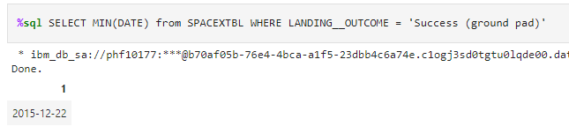
First Successful Ground Landing Date
The MIN reserved key word was used to identify the first record with a Success (ground pad) landing outcome

Slide 29
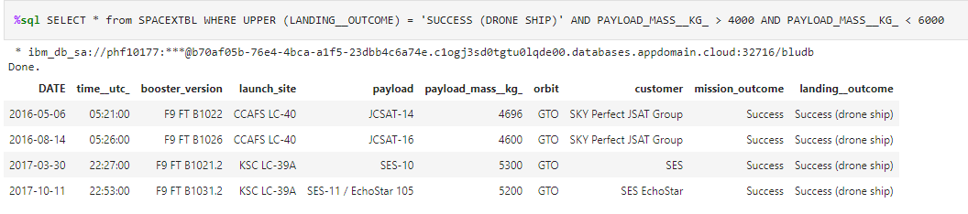
Successful Drone Ship Landing with Payload between 4000 and 6000 kg
The AND reserved keyword was used to apply multiple conditions to the where clause, filtering the results to success (drone ship) landing outcomes with payloads between 4000 and 6000 kg

Slide 30
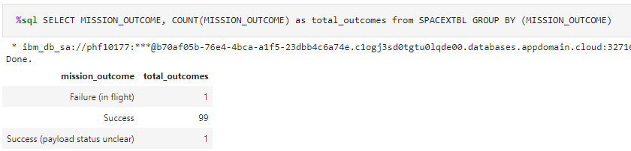
Total Number of Successful and Failure Mission Outcomes
The GROUP BY clause was used in conjunction with the COUNT aggregate function to count the different mission outcomes

Slide 31
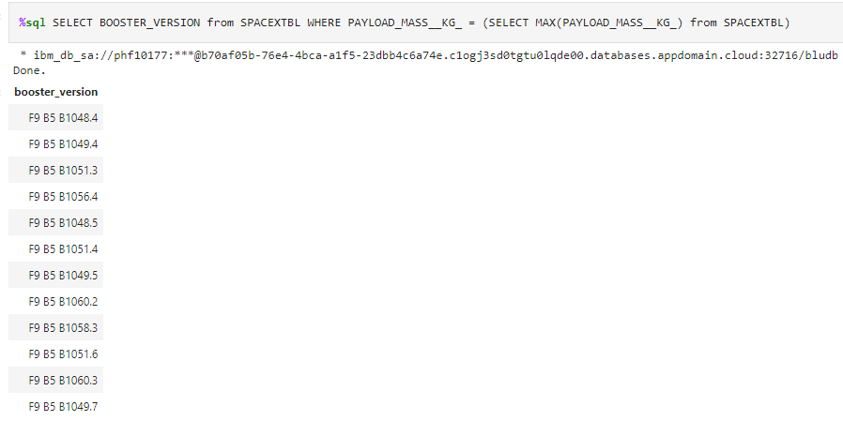
Boosters Carried Maximum Payload
A subquery was used to identify the largest payload and then the where clause was used to identify booster versions that have carried this max payload

Slide 32
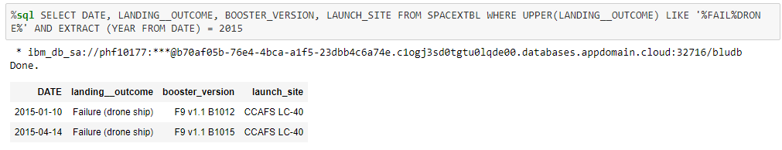
2015 Launch Records
The EXTRACT YEAR reserved key phrase was used in conjunction with the ‘%’ wildcard to identify all drone landing failures in 2015

Slide 33
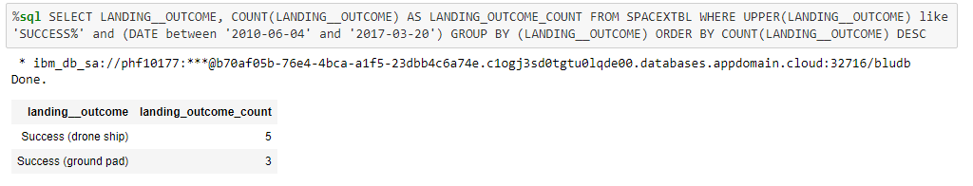
Rank Landing Outcomes Between 2010-06-04 and 2017-03-20
In order to rank the landing outcomes between June 4, 2012 and March 20, 2017, a complex query was written
The query used the GROUP BY clause in combination with the COUNT aggregate function to get the counts for each landing outcome
The reserved AND keyword was used to apply multiple filtering conditions in the where clause
The reserved DESC keyword was used in the group by clause in order to list the more prevalent landing outcomes first

Slide 34

Section 3

Slide 35
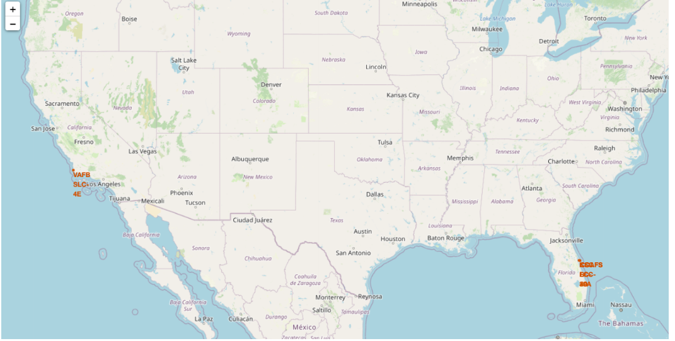
All launch sites’ location markers on global map
The launch sites are all located along continental American coastlines

Slide 36
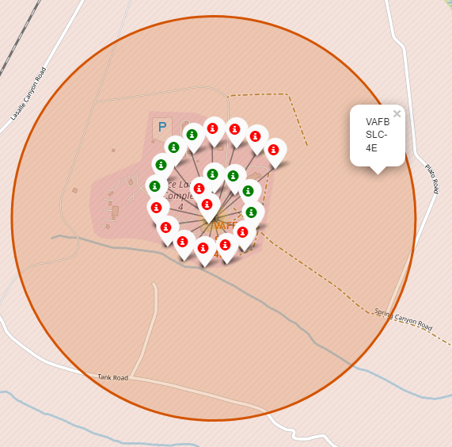
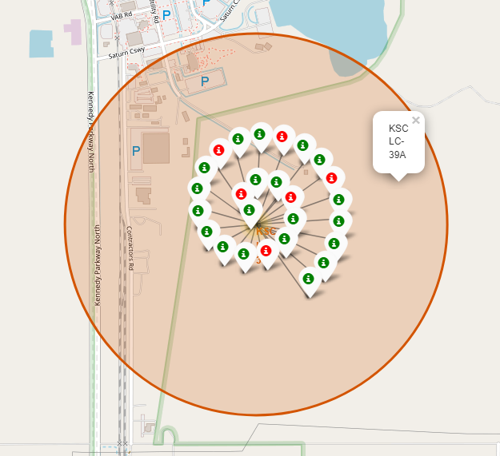
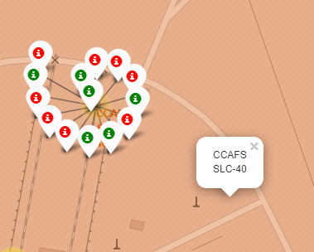
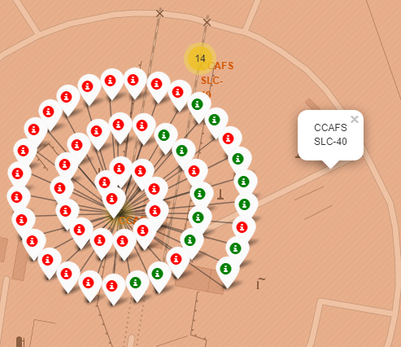
Color labeled launch outcomes on map
West Coast California Launches
East Coast Florida Launches
Launch Success
Launch Failure

Slide 37
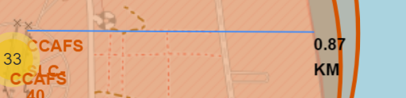
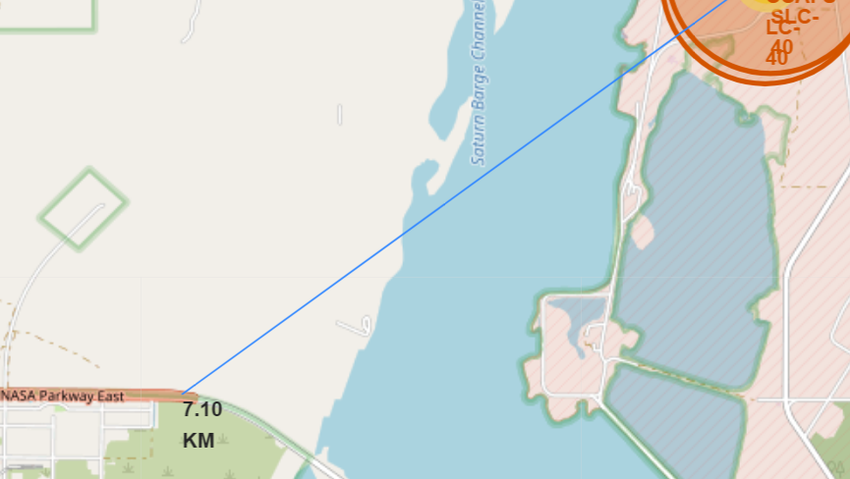
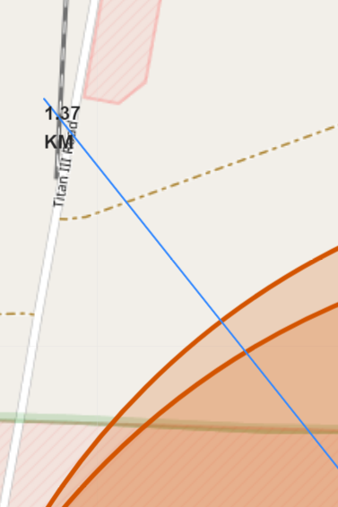
Launch site proximities
Distance to nearest city: 78.45 km
Distance to coastline: 0.87 km
Distance to nearest highway: 7.10 km
Distance to nearest railway: 1.37 km

Slide 38

Section 4

Slide 39
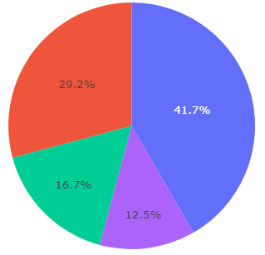
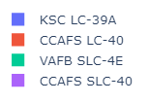
Pie chart of launch success count for all sites
The pie chart shows that the KSC LC-39A launch site had the largest percentage of successful launches when compared to the other sites

Slide 40
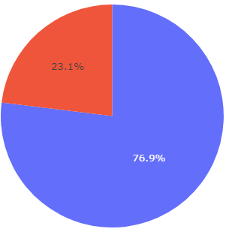
Pie chart for launch site with highest launch success ratio; KSC LC-39A
The success rate for the KSC LC-39A site was over three quarters at 76.9%
Success
Failure

Slide 41
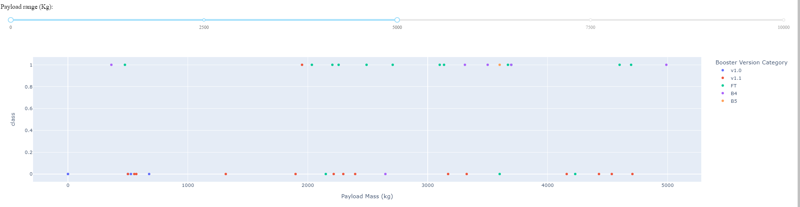
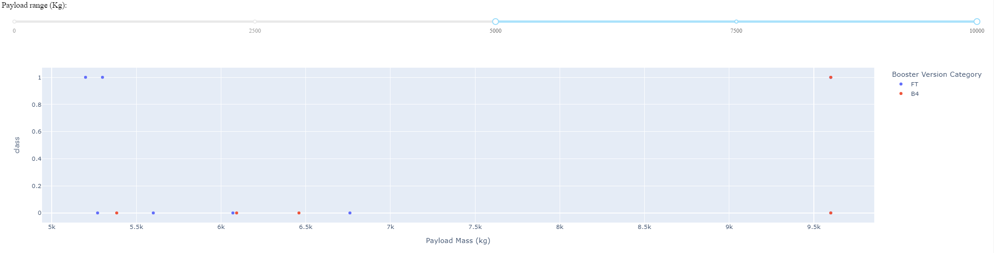
Scatter plot for Payload vs. Launch Outcome (all sites)
Launch Success for payload between 0 and 5000 kg
Launch Success for payload between 5000 and 10000 kg
The scatter plot shows significantly more successful launches with lower weighted payloads

Slide 42

Section 5

Slide 43
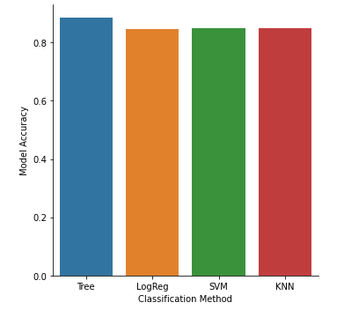
Classification Accuracy
The following bar chart shows the Decision Tree classification algorithm producing the most accurate prediction model.

Slide 44
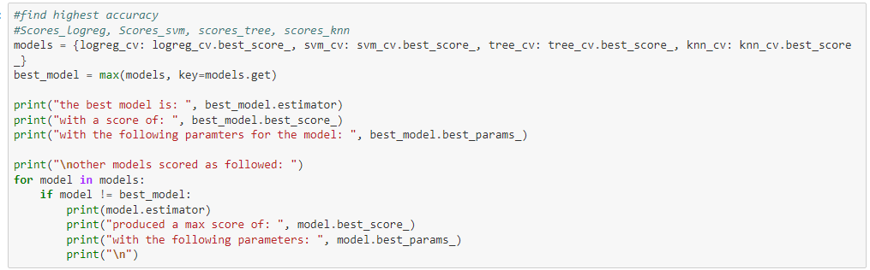
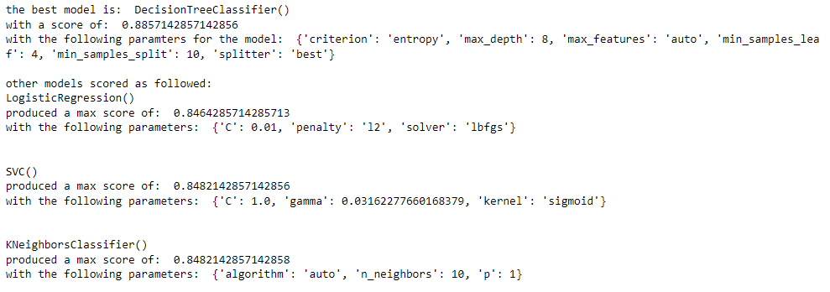
Classification Accuracy

Slide 45
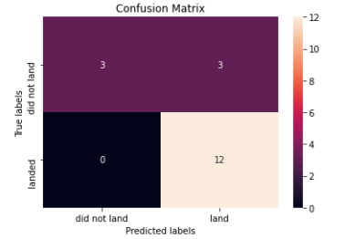
Confusion Matrix – Decision Tree Classifier
The confusion chart matrix for the decision tree classifier indicates the ability to successfully classify the separate outcomes
The only draw back is in the amount of false positives, where the actual data indicated an unsuccessful landing, but the model classified the outcome as a successful landing

Slide 46
Conclusions
Launch success rate increased from 2013 till 2020
Orbits ES-L1, GEO, HEO, and SSO had a success rate superior to other orbits
Payload Mass impacted the success rate of some orbits but not all
The Decision Tree Classifier is the most accurate model for classifying successful launches

Slide 47


